Slide 1


SAPTHAGIRI COLLEGE OF ENGINEERING (Affiliated to Visvesvaraya Technological University, Belagavi & Approved by AICTE, New Delhi) Department of Information Science & Engineering
Internship presentation on Python and Machine Learning
“Prediction of Cancer Type using KNN algorithm”
Guided by:
Dr. H R RANGANATHA
HOD, Dept of ISE, SCE
Presented by:
SRI VARSHNI K S
1SG18IS107

Slide 2
Contents
Introduction about the company
Overview of the organization
Tasks performed
Learning Experience
Knowledge Acquired
Skills Learned
The most challenging task performed
Problem Identified
4. Reflection
5.Conclusion

Slide 3
Introduction about the company
Karunadu Technologies Pvt. Ltd. is a leading IT software solutions and services industry focusing on quality standards and customer values.
Karunadu Technologies Pvt. Ltd. offers cost effective highly scalable products for varied verticals. They focus on creating sustainable value growth through innovative solutions and unique partnerships.
Their other products include:
KECMS – Karunadu Enterprise Content Management System
KEMS – Karunadu Education Management System
KASS – Karunadu Advanced Security System
Dept of ISE, SCE
Python and Machine Learning
1

Slide 4
Overview of the organization
Vision:
To be a world-class research and development organisation committed to enhancing stakeholder’s value.
Mission:
To build best products that are socially innovative with high-quality attributes and provide excellent education to all.
Values:
Zeal to excel and zest for change.
Integrity and fairness in all matters
Respect for dignity and potential of individuals
Strict adherence to commitments.
Ensure speed of response.
Faster learning, creativity and team-work.
Dept of ISE, SCE
Python and Machine Learning
2

Slide 5
Learning Experience
An internship is composed of an array of learning experiences to examine real world encounters, problems and solutions.
Internship helped us learn the basic concepts of python and applications of machine learning algorithms to different datasets and predict the results.
Internship introduced us with the real life work problems and hence helped develop problem solving skills.
Dept of ISE, SCE
Python and Machine Learning
3

Slide 6
Knowledge Acquired
About python programming language
What is Machine Learning and how it works?
Types of Machine Learning
Different Machine Learning algorithms and its working
Designer tool
Open CV for image and video processing
Dept of ISE, SCE
Python and Machine Learning
4

Slide 7
Skills Learned
Python basics
Python libraries
Built-in data types
Operators
Python collections (arrays)
Machine learning
Types of Machine learning
KNN algorithm
Dept of ISE, SCE
Python and Machine Learning
5

Slide 8
The most challenging task performed
The most challenging part was to learn different machine learning algorithms and their working in a short period of time, to understand the new concepts and to learn how to make use of it in real time problems.
It was a challenge to decide which data pre-processing technique is suitable for the given dataset and replacing the missing values by various methods.
Choosing the appropriate algorithm for the given datasets and applying them to get accurate results and also deciding which input features contribute in predicting the accurate output posed a challenge.
Dept of ISE, SCE
Python and Machine Learning
6

Slide 9
Problem Identified
Capacity may not fulﬁll the exact requirement of any adverse situation
Wrong or misinterpretation or anomaly in data or wrong assumption can cause failure to detect absolute/correct result.
Not user friendly
Dept of ISE, SCE
Python and Machine Learning
7

Slide 10
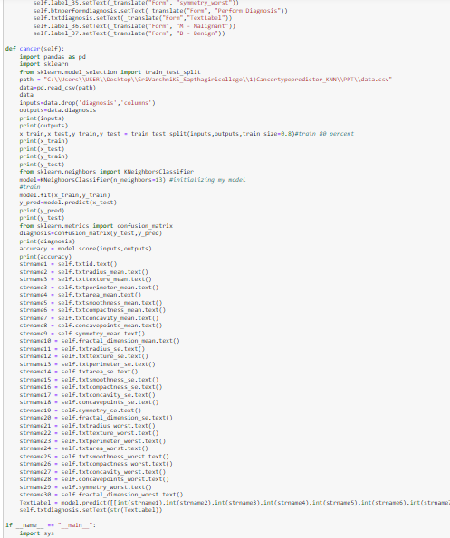
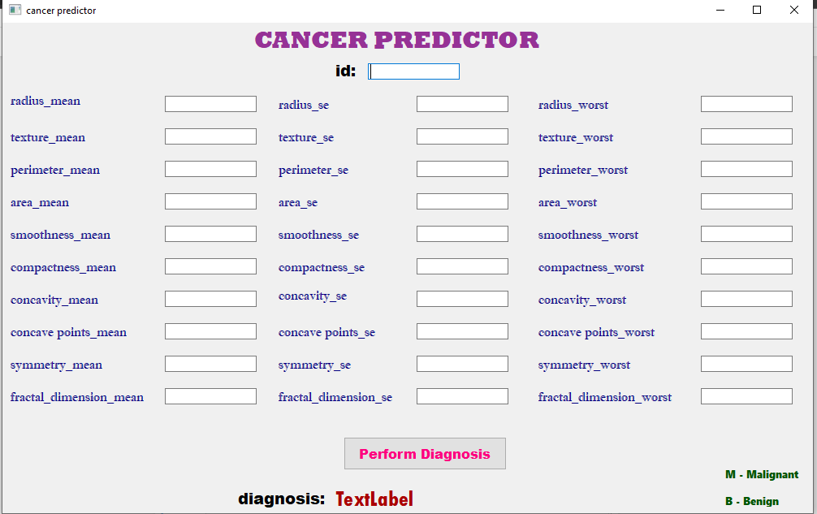
Reflections
Dept of ISE, SCE
Python and Machine Learning
8

Slide 11
Conclusion
It was an amazing experience to do internship at Karunadu Technologies. We were introduced to the world of python and Machine Learning.
Many algorithms were introduced, advantages, disadvantages and characteristics of these algorithms were taught.
This internship gave us the spirit to learn ML and their concepts in a deeper manner.
Projects assigned helped us to understand how to apply the algorithms in a most efficient manner and predict the results for given datasets.
Dept of ISE, SCE
Python and Machine Learning
9

Slide 12
T H A N K Y O U

